Slide 1
NoSQL and Graph Databases: Principles

Slide 2
Agenda
Graph Databases: Mission, Data, Example
A Bit of Graph Theory
Graph Representations
Types of Queries
Graph Databases
Neo4j
Data model
Traversal of the graph
Cypher query language

Slide 3
RDBMS recap
RDBMS are predominant database technologies
Since 1970
Data modeled as relations (tables)
object = tuple of attribute values
tables contain objects of the same type
tables interconnected via foreign keys
Use SQL query language

Slide 4
Advantages of Relational Databases
A (mostly) standard data model
Many well developed technologies
physical organization of the data
search indexes: hash indexes
query optimization, search operator implementations
Reliable concurrency control (ACID)
transactions: atomicity, consistency, isolation, durability
Many reliable integration mechanisms
“shared database integration” of applications

Slide 5
NoSQL Databases
What is “NoSQL”?
term used in late 90s for a different type of technology
“Not Only SQL”?
but many RDBMS are also “not just SQL”
“NoSQL is an accidental term with no precise definition”
first used at an informal meetup in 2009 in San Francisco (presentations from Voldemort, Cassandra, Dynomite, HBase, Hypertable, CouchDB, and MongoDB)
[Sadalage & Fowler: NoSQL Distilled, 2012]

Slide 6
NoSQL Databases..
NoSQL: Database technologies that are (mostly):
Not using the relational model (nor the SQL language)
Designed to run on large clusters (horizontally scalable)
No schema - fields can be freely added to any record
Based on the needs of 21st century web estates
[Sadalage & Fowler: NoSQL Distilled, 2012]
Other characteristics (often true):
easy replication support (fault-tolerance, query efficiency)
simple API
eventually consistent (not ACID)

Slide 7
Four Basic Types of NoSQL Databases
Key-value stores
Document databases
Column-family stores
Graph databases
In this course we will discuss only graph databases and document databases in details

Slide 8
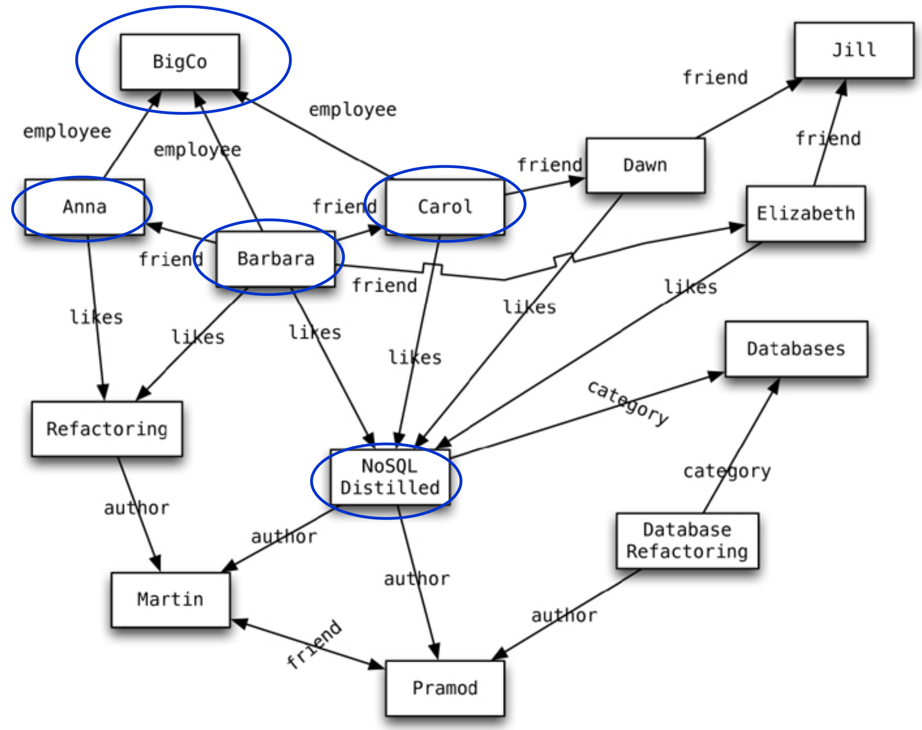
Graph Databases: Example
source: Sadalage & Fowler: NoSQL Distilled, 2012

Slide 9
Graph Databases: Mission
To store entities and relationships between them
Nodes are instances of objects
Nodes have properties, e.g., name
Edges connect nodes and have directional significance
Edges have types e.g., likes, friend, …
Nodes are organized by relationships
Allow to find interesting patterns
example: Get all nodes that are “employee” of “Big Company” and that “likes” “NoSQL Distilled”

Slide 10
Basic Characteristics
Different types of relationships between nodes:
To represent relationships between domain entities,
or to model any kind of secondary relationships
Category, path, time-trees..
No limit to the number and kind of relationships
Relationships have: type, start node, end node, own properties
e.g., “since when” did they become friends

Slide 11
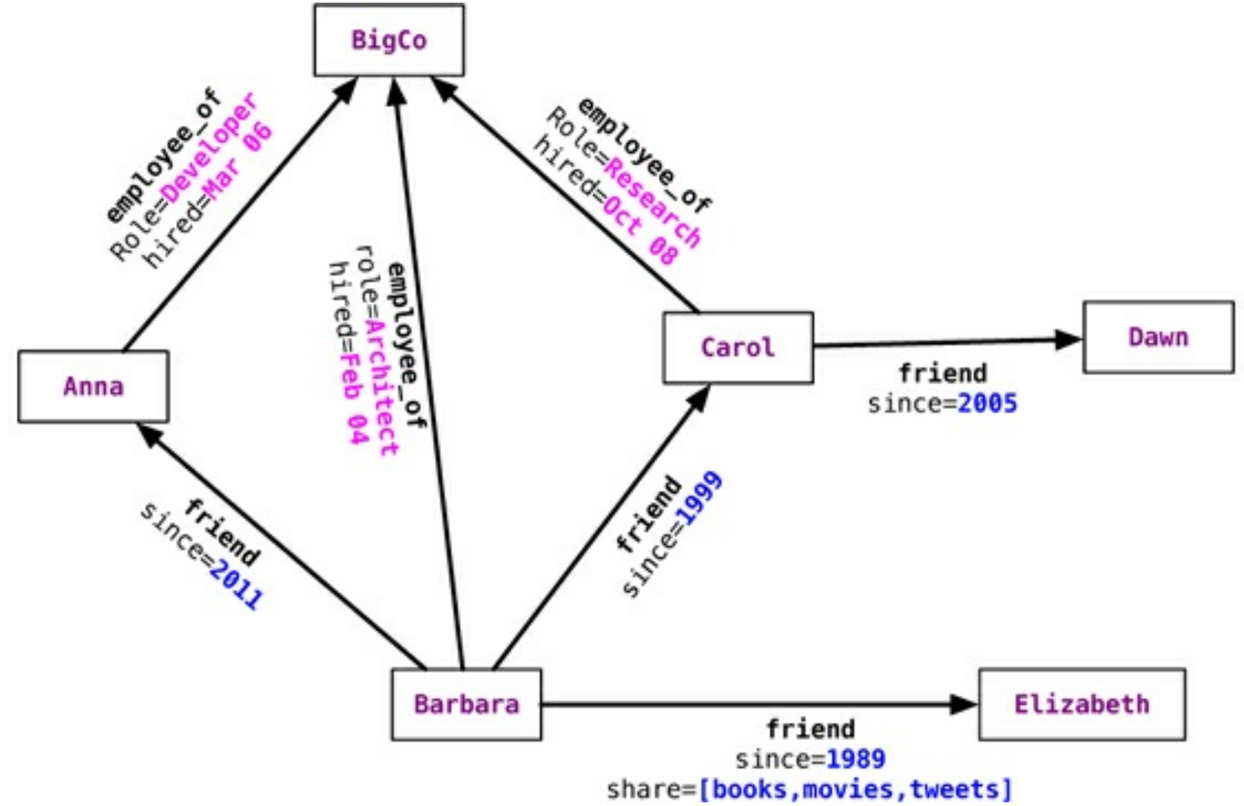
Relationship Properties: Example
source: Sadalage & Fowler: NoSQL Distilled, 2012

Slide 12
A Bit of a Theory
Data: a set of entities and their relationships
=> we need to efficiently represent graphs
Basic operations:
finding the neighbours of a node,
checking if two nodes are connected by an edge,
updating the graph structure, …
=> we need efficient graph operations
A graph G = (V, E) is a pair commonly modelled as
set of nodes (vertices) V
set of edges E
n = |V|, m = |E|
Which data structure to use?

Slide 13
Data Structure: Adjacency Matrix
Two-dimensional array A of n ⨉ n Boolean values
Indexes of the array = node identifiers of the graph
Boolean value A_{ij} indicates whether nodes i, j are connected
Variants:
(Un)directed graphs
Weighted graphs…

Slide 14
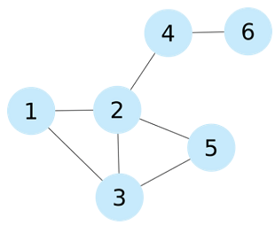
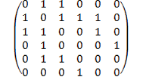
Adjacency Matrix: Example
1 2 3 4 5 6
1
2
3
4
5
6

Slide 15
Adjacency Matrix: Example
Pros:
Adding/removing edges
Checking if 2 nodes are connected
Cons:
Quadratic space: O(n²)
We usually have sparse graphs
Adding nodes is expensive
Retrieval of all the neighbouring nodes takes linear time: O(n)
1 2 3 4 5 6
1
2
3
4
5
6

Slide 16
Data Structure: Adjacency List
A set of lists, each enumerating neighbours of one node
A vector of n pointers to adjacency lists
Undirected graph:
An edge connects nodes i and j
=> the adjacency list of i contains node j and vice versa
Often compressed
Exploiting regularities in graphs, difference from other nodes, …

Slide 17
Adjacency List: Example
1 -> {2, 3}
2 -> {1, 3, 4, 5}
3 -> {1, 2, 5}
4 -> {2, 6}
5 -> {2, 3}
6 -> {4}

Slide 18
Adjacency List: Example
Pros:
Getting the neighbours of a node
Cheap addition of nodes
More compact representation of sparse graphs
Cons:
Checking if there is an edge between two nodes
1 -> {2, 3}
2 -> {1, 3, 4, 5}
3 -> {1, 2, 5}
4 -> {2, 6}
5 -> {2, 3}
6 -> {4}

Slide 19
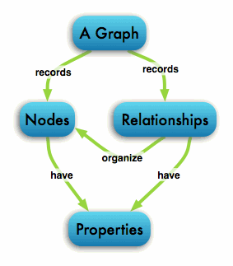
Graphs Relationships
Single-relational graphs
Edges are homogeneous in meaning
e.g., all edges represent friendship

Slide 20
Graphs Relationships..
Multi-relational (property) graphs
Edges are typed or labeled
e.g., friendship, business, communication
Vertices and edges maintain a set of key/value pairs
Representation of non-graphical data (properties)
e.g., name of a vertex, the weight of an edge

Slide 21
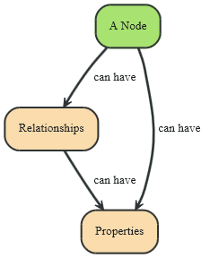
Neo4j: Data Model
Fundamental units: nodes + relationships
Both can contain properties
Key-value pairs
Value can be of primitive type or an array of primitive type
null is not a valid property value
nulls can be modelled by the absence of a key
http://db-engines.com/en/system/Neo4j

Slide 22
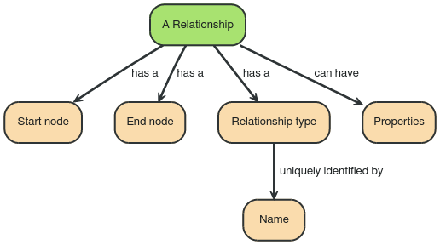

Data Model: Relationships
Directed relationships
Incoming and outgoing edge
Equally efficient traversal in both directions
Direction can be ignored when not needed by applications
Always have start and end node
Can be recursive

Slide 23
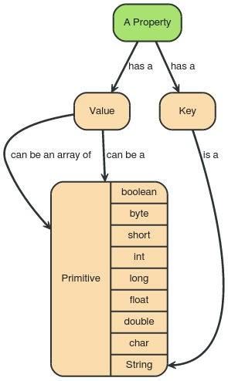
Data Model: Properties
Type | Description
boolean | true/false
byte | 8-bit integer
short | 16-bit integer
int | 32-bit integer
long | 64-bit integer
float | 32-bit IEEE 754 floating-point number
double | 64-bit IEEE 754 floating-point number
char | 16-bit unsigned integers representing Unicode characters
String | sequence of Unicode characters

Slide 24
Graphs (Neo4j) vs. RDBMS
RDBMS designed for a single type of relationship
“Who is my manager”
Adding another relationship usually means a lot of schema changes
In RDBMS we model the graph beforehand based on the traversal we want
If the traversal changes, the data will have to change
Graph DBs: the relationship is not calculated but persisted

Slide 25
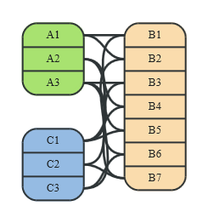
Graphs (Neo4j) vs. RDBMS (2)
RDBMS is optimized for aggregated data
Neo4j is optimized for highly connected data
It uses adjacency list as a data structure
Relational data
source: http://neo4j.com/docs/stable/

Slide 26
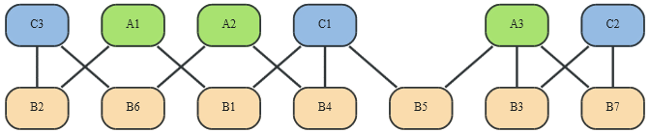
Graphs (Neo4j) vs. RDBMS (2)
RDBMS is optimized for aggregated data
Neo4j is optimized for highly connected data
It uses adjacency list as a data structure
Relational data
Graph data
source: http://neo4j.com/docs/stable/

Slide 27
Graph DBs: Suitable Use Cases
Connected Data
Social networks
Any link-rich domain is well suited for graph databases
Routing, Dispatch, and Location-Based Services
Node = location or address that has a delivery
Graph = nodes where a delivery has to be made
Relationships = distance
Recommendation Engines
“your friends also bought this product”
“when buying this item, these others are usually bought”

Slide 28
Graph DBs: When Not to Use
If we want to update all or a subset of entities
Changing a property on many nodes is not straightforward
e.g., analytics solution where all entities may need to be updated with a changed property
Some graph databases may be unable to handle lots of data
Distribution of a graph is difficult

Slide 29
Neo4j: Basic Info
Open source graph database
Initial release: 2007
Written in: Java
OS: cross-platform
Full transactions (ACID)
Partitioning: None
Replication: Master-slave
Eventual consistency

Slide 30
Neo4j in Server mode
Two ways to use Neo4j:
Self-standing server + connections
Embeded: Used directly within a Java application
Server mode:
download from https://neo4j.com/download-center/
extract neo4j-community-X.Y.Z.tar.gz
start neo4j and create a new graph database
go to: http://localhost:7474/

Slide 31
Cypher: Common Clauses
MATCH: The graph pattern to match
WHERE: Filtering criteria
RETURN: What to return
CREATE: Creates nodes and relationships.
DELETE: Remove nodes, relationships
REMOVE: Removes properties from nodes and relationships
SET: Set values to properties
WITH: Divides a query into multiple parts

Slide 32
Cypher: Creating Nodes
CREATE n;
(create a node, assign to var n)
CREATE (p: Employee {name : 'David'})
RETURN p;
(create a node with label ‘Employee’ and ‘name’ property ‘David’)

Slide 33
Cypher: Creating Nodes
CREATE
(a:Airport{name:"Schiphol",city:"Amsterdam",capacity:20000, size:"Medium"})
<-[i1:Includes]-(t1:Terminal{code:"A", open:true}),
(a)<-[i2:Includes]-(t2:Terminal{code:"B", open:false}),
(a)<-[i3:Includes]-(t3:Terminal{code:"C", open:true}),
RETURN a
(create a node labeled as ‘Airport’ with some properties that includes multiple terminals’)

Slide 34
Cypher: Creating Nodes
# assuming there is a node with the property name ‘Schiphol’
MATCH (a:Airport{name:"Schiphol"})
CREATE
(a)<-[t1:Travel{from:"Berlin", dep:time("13:00")}]-(f1:Flight{code:"12f"}),
(a)<-[t2:Travel{from:"Verona", dep:time("15:33")}]-(f2:Flight{code:"1245"})
RETURN a
(match an existing node labeled as ‘Airport’ and named as ‘Schiphol’, then create multiple flights that travel to this this airport)

Slide 35
Cypher: Selecting Nodes
# assuming you have multiple nodes that have ‘Works’ relationship with other nodes
MATCH (n)-[:Works]-(m) RETURN n
(find all nodes that have similar relationships no matter in which direction)
MATCH (n)-[:Works]->(m) RETURN n
(find all nodes that have similar relationships where the direction is specified from left to right)
MATCH (n)<-[:Works]-(m) RETURN n
(find all nodes that have similar relationships where the direction is specified from right to left)

Slide 36
Cypher: Changing Properties
# assuming only one employee with the name ”Andres” exists
MATCH (p: Employee {name: 'Andres'})
SET p.surname = 'Taylor'
RETURN p
(find a node with name ‘Andres’ and set it surname ‘Taylor’)

Slide 37
Cypher: Deleting Nodes
# assuming some nodes labeled as employees with different names exists
MATCH (p: Employee {name: 'Andres'})
DELETE p
(delete all employees with the name ‘Andres’)
# assuming a node with the name ‘Andres’ exists
MATCH (p: Employee {name: 'Andres’})
DETACH DELETE p
(Delete all relationships of node with name ‘Andres’)

Slide 38
Cypher: Finding Nodes and Matching Patterns
# assuming age property is created
MATCH (p: Employee)
WHERE p.age > 18 AND p.age < 30
RETURN p.name
(return names of all employees between 18 and 30)
# assuming the relationship “works” to the node company is created
MATCH (p: Employee) – [w:Works]-> (c:Company{location: “New York”})
RETURN p.name, c.name
(find all ‘employees’ that have a work relationship with a company located in ‘new york’)

Slide 39
Cypher: Finding Nodes and Matching Patterns
# assuming some airports with the property size that have relationships to other nodes are created
MATCH (a:Airport{size:"Medium"})-[i]-(m)
RETURN a.name, type(i), count(i)
(Find all medium sized airports, their relationships and the number of the relationships of the same type)
# assuming some airport nodes and their relationships to other nodes exists
MATCH (a:Airport)-[r]-(m)
WITH a.name AS airportname, type(r) AS tr ,count(r) AS cnt
WHERE cnt > 3 and cnt < 10
RETURN *
(Find all airports, their relationships and the number of the relationships of the same type and return only those where the number of relations of the same kind is between 3 and 10)

Slide 40
Cypher: Queries (2)
# assuming the node with the name ‘Andres’ is related through many intermediate nodes to other nodes
MATCH (andres: Employee {name: 'Andres'})-[*1..3]-(n)
RETURN andres, n ;
(find all nodes within three hops from ‘Andres’)
# assuming the node with the name ‘Andres’ is related through different intermediate nodes to the node with the name ‘David’
MATCH p=shortestPath(
(andres:Employee {name: 'Andres'})-[*]-(david {name:'David'})
)
RETURN p ;
(find the shortest connection between ‘Andres’ and ‘David’)

Slide 41

Table translation
You cannot translate tables directly.
In a RDBMS you define the structure of the table.
In a Graph DB you insert the data as nodes and you give them a type
CREATE (p:Person{name :‘Jim Raynor’, address: ’Somehwere’ , job: ’Detective’, married:false}) RETURN p;

Slide 42
Join table translation
In a RDBMS you model relationship as tables.
The relationship is modelled as data with PK-FK connections.
In a Graph DB you can type the edges and use them as relationships.
*
Works for
*
Employee
Company
Hours
Position
Name
Name
Location
Position

Slide 43
Guidelines on Data model Transformation (Relational -> graph )
Each entity table is represented by a label on nodes
Each row in a entity table is a node
Columns on those tables become node properties.
Replace foreign keys with relationships to the other table
Remove data with default values, no need to store those
Indexed column names, might indicate an array property (like email1, email2, email3)
Join tables are transformed into relationships, columns on those tables that are not part of the primary key become relationship properties
Each relationship which is not binary (ternary, quaternary, …) becomes a node in the graph. All the attributes of the relationship are stored in the node. All entities participating in the relationship are linked to this node.

